Slide 1


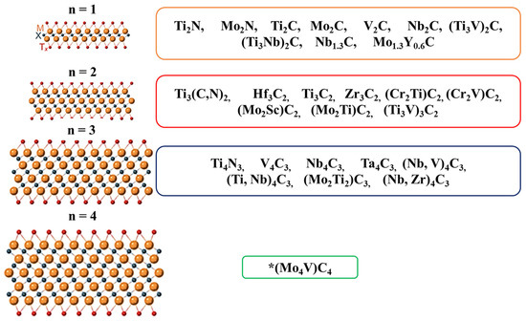
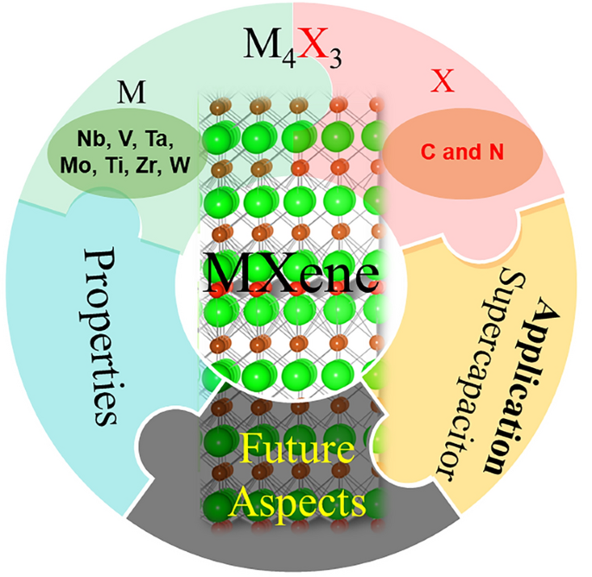
Characterizing Structural and Thermal Properties of Nb₄C₃T_{x} MXenes
Jianna Evans, Nisha H. Makani, Bhoj Gautam
Department of Chemistry, Physics and Materials Science, Fayetteville State University, Fayetteville, North Carolina 28301, United States of America
Abstract
Synthesis and characterization of Nb₄C₃T_{X} MXenes
Results and Discussions
Nb-based MXenes, such as Nb₄C₃T_{X}, exhibit high electrical conductivity, making them well-suited for energy storage and electronic applications. However, the greater stability of Nb-based MAX phases poses challenges in the etching and, consequently, is difficult to prepare as MXenes. Additionally, Nb-based MXenes are highly susceptible to oxidation, altering their fundamental properties. This study focuses on Nb₄C₃T_{x} MXenes, investigating their structural and thermal properties using XRD, SEM, Raman spectroscopy, TGA, and DSC measurements. Thermal analysis plays a crucial role in determining materials' structural integrity and potential applications under high-temperature conditions. XRD analysis confirmed the successful etching of aluminum, as evidenced by the disappearance of the characteristic aluminum peak, validating the preparation process. Raman spectra show significant peaks at ~300 and 677 cm⁻¹ belonging to Nb-O and Nb-C respectively. TGA was utilized to measure thermal stability, oxidation analysis, and degradation behavior by monitoring the critical change in weight percentage. DSC measurements indicate no significant thermal events up to 300°C during heating and cooling cycles. Overall, this analysis aims to contribute to the information database of properties to extend the possible applications of Nb₄C₃T_{X}. This comprehensive analysis provides valuable insights into the structural and thermal behavior of Nb₄C₃T_{X} MXenes, contributing to the knowledge base necessary for their potential application in high-temperature and oxidation-sensitive environments. The findings aim to expand the scope of Nb-based MXenes for future technological advancements.
TGA, (Room Temp to ~300°C): Slight weight loss (~1–2%) observed, due to Evaporation of adsorbed water, Possible desorption of surface groups (e.g., –OH, –F).
(300–500 °C):The weight remains almost constant. Indicates high thermal stability.
(500–650 °C): an increase in weight (~4–5%) is seen, Formation of niobium oxides (e.g., Nb₂O₅)
DSC, Heat flow stabilizes, indicating no major phase transitions.
Slight increase in heat flow, which is due to the Minor surface rearrangements of the functional group
TGA
HF etching 96 hours at RT
Nb₄AlC₃ MAX phase
Nb₄C₃T_{X} MXene multilayers
a
b
DSC
1 gram of Nb₄AlC₃ powder was treated with 10 mL of HF at RT for 96 hours with uniform stirring.
After the reaction was complete, the resulting mixture was washed sequentially with hydrochloric acid (HCl) and deionized (DI) water until the pH of the solution reached approximately 6.
The sample was then dried in an oven at 60 °C for 24 hours. The obtained MXene was subsequently used for various characterizations, including XRD, SEM, Raman spectroscopy, TGA, and DSC."
Summary
XRD and SEM analyses confirm the etching of Nb₄C₃CTₓ, as evidenced by the appearance of the characteristic etching peak and the sheet-like morphology.
However, the appearance of an additional peak attributed to oxide formation suggests that Nb-based MXenes are susceptible to oxidation during synthesis, highlighting the need for further optimization of the etching process
Raman spectroscopy also reveals signs of oxidation in the MXene structure.
Nb₄C₃Tₓ MXene shows good thermal stability up to ~500 °C.
Results and Discussions
XRD
SEM
Raman
Introduction
The etching of Nb₄AlC₃ is confirmed by the appearance of a characteristic peak at 6.17° and 7.17°, corresponding to the (002) and (004) plane reply. A noticeable shift toward lower angles suggests an increased interlayer spacing due to sheet separation.
SEM analysis further confirms the formation of Nb₄C₃Tₓ, revealing micro- and nanoscale sheet-like structures.
The Raman peaks at show significant peaks at 133 cm⁻¹, Out-of-plane vibrations of niobium (Nb) atoms, 249 cm⁻¹: Nb-C stretching vibrations, 300 cm⁻¹: Mixed vibrations involving Nb-C bonds and Nb-T (T = surface terminations such as -O, -OH), 677 cm⁻¹: Vibrations associated with surface functional groups, particularly Nb-O or Nb-OH terminal bonds; may also indicate the presence of Nb₂O₅ due to surface oxidation.
Acknowledgement
The synthesis and characterization work was supported by DOE BES award number DE-SC0024611.
a
b
Large surface area
References
Tunable surface chemistry
Lee, K., Kwon, S. Y., Choi, J., Kim, J., Woo, T., Ryu, J., ... & Lee, J. H. (2024). Journal of Materials Chemistry C, 12(3), 893-902.
Lipatov, A., Alhabeb, M., Lu, H., Zhao, S., Loes, M. J., Vorobeva, N. S., ... & Sinitskii, A. (2020). Advanced Electronic Materials, 6(4), 1901382.
Lan, L., Ni, Z., Zhao, C., Gao, J., Tang, X., Qu, Z., ... & Qiu, T. (2024). Langmuir, 40(40), 20945-20953.
High conductivity
Applications
Sensors
Contact Information:
Dr. Bhoj Gautam, Department of Chemistry, Physics and Materials Science
Fayetteville State University, Fayetteville, NC-28301
Email: bgautam@uncfsu.edu, Phone: 910-672-1653
EMI shielding
Electrocatalysis

